Slide 1
Car parts bids of parties
By Adnan Majeed
Computer Learning Center

Slide 2
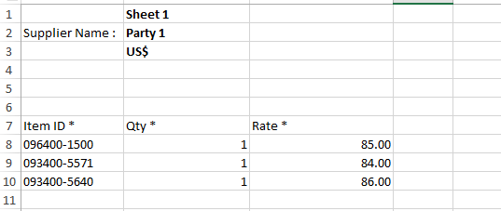
Create sheet like this party 1 data

Slide 3
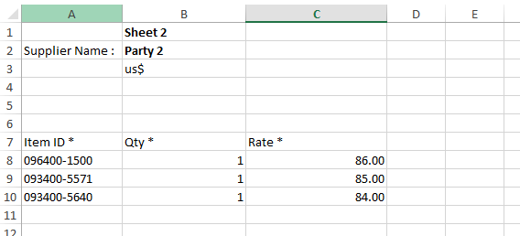
Party 2 data

Slide 4
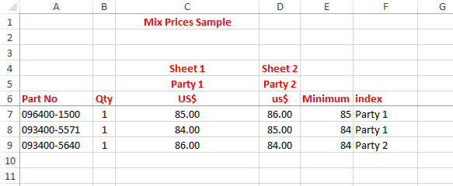
Final mix price data

Slide 5
Formula
=MIN(C7:D7)
=INDEX(C$5:D$5,,MATCH(E7,C7:D7,0))

